Slide 1


Slide 2

GitHub

Slide 3
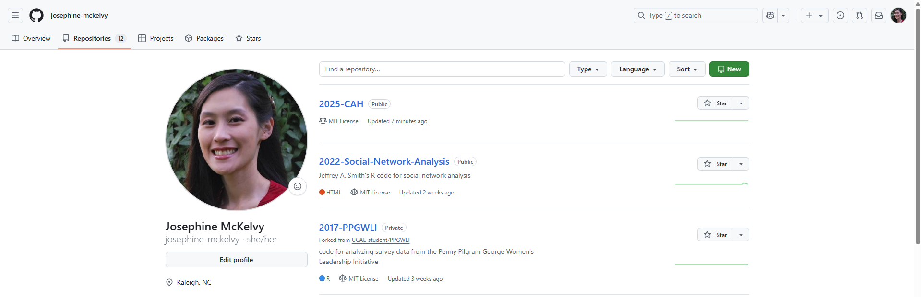
Notes:
Sign in to GitHub.
Create a new repository.

Slide 4
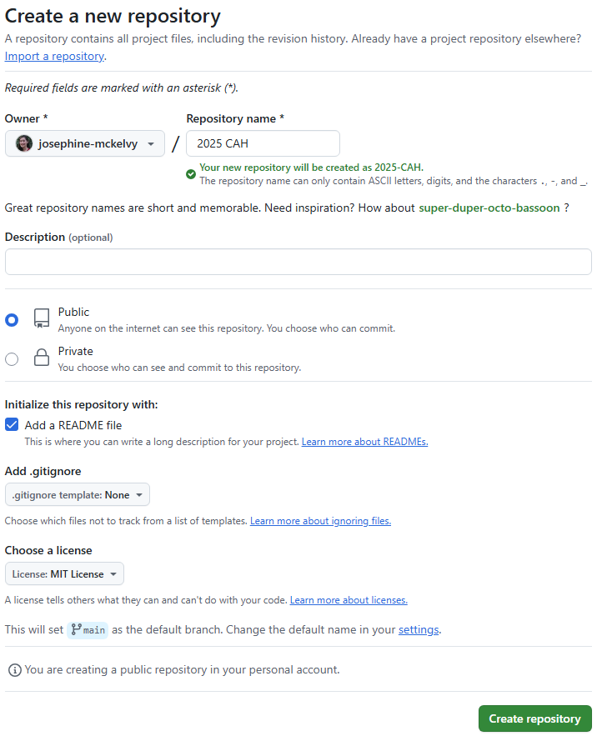
Notes:
Name the repository.
Add a README file.
Choose a license.

Slide 5


Slide 6
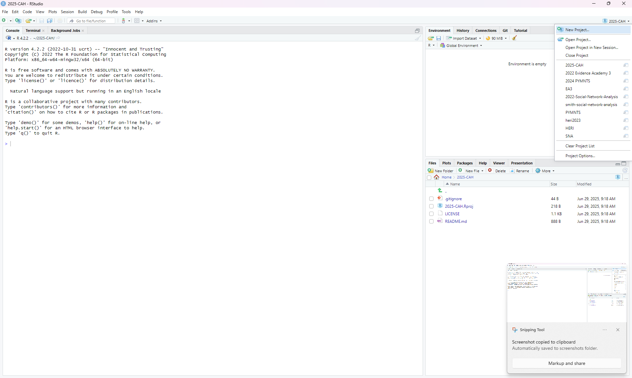
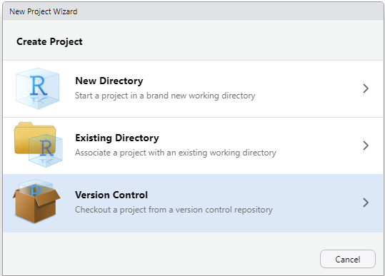
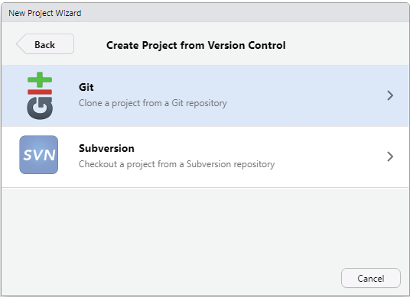
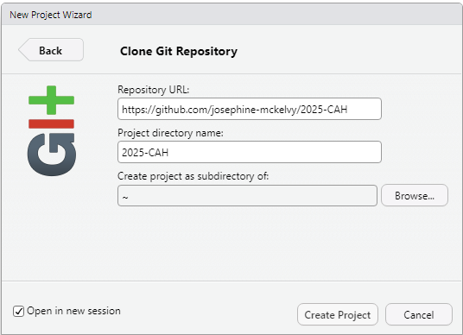
Notes:
Create a New Project.
Checkout a project from a Version Control repository.
Clone a project from a Git repository.
Use the URL for the repository you just created in GitHub.

